Slide 1




APPLIED PREDICTIVE ANALYTICS | AI & DATA SCIENCE
EVCharge Intelligence
A Predictive Analytics Framework for EV Charging Demand, Station Congestion and Customer Feedback Analysis
B. Praneeth Reddy
Syed Afroz
Chaitanya Turangi
Roll No: 160124771028
Roll No: 160124771059
Roll No: 160124771060
Chaitanya Bharathi Institute of Technology
Department of AI & Data Science | Applied Predictive Analytics
SMART MOBILITY • PREDICTIVE ANALYTICS
Notes:
Good morning. We are B. Praneeth Reddy, Syed Afroz and Chaitanya Turangi from AI & Data Science, CBIT. Our project is EVCharge Intelligence, a predictive analytics framework for EV charging demand, congestion and customer feedback.

Slide 2



Problem Statement & Objectives
Why EV charging operators need prediction, not just reporting
Variable demand
Station congestion
Traffic & weather
Customer experience
EV charging demand is variable across time and stations.
Charging stations can become congested.
Traffic and weather can influence demand.
Experience varies between stations.
PROJECT OBJECTIVES
1
2
3
4
5
›
›
›
›
Predict charging demand
Predict station congestion
Analyze customer feedback
Compare stations / cities
Build interactive Power BI dashboard
EVCharge Intelligence | 2 / 11
Notes:
EV charging demand changes with time, traffic and weather, so stations can get congested and customer experience varies. We set five objectives, from predicting demand and congestion to building an interactive Power BI dashboard.

Slide 3
Dataset & Features
EVCharge_Intelligence_Dataset.csv | 12,000 records × 15 columns
12,000
15
6
24
0
Records
Raw columns
Cities
Stations
Missing / duplicates
Timestamp | Station_ID | City | Connector | Vehicle | Weather | Traffic | Energy_kWh | Pred_kWh | Pred_Cong.
2025-03-16 10:15:00 | CHE-ST-03 | Chennai | DC Fast | Electric Taxi | Sunny | Low | 17.89 | 21.15 | Medium
2025-05-21 00:29:00 | CHE-ST-04 | Chennai | AC | Sedan EV | Sunny | Medium | 13.09 | 13.27 | Low
2025-09-27 13:22:00 | BEN-ST-02 | Bengaluru | AC | SUV EV | Rainy | Medium | 16.29 | 17.27 | Medium
2025-08-25 03:15:00 | BEN-ST-04 | Bengaluru | AC | Hatchback EV | Rainy | Medium | 12.32 | 11.64 | Low
2025-12-30 12:41:00 | BEN-ST-03 | Bengaluru | AC | SUV EV | Stormy | Medium | 19.68 | 19.64 | Low
INPUT FEATURES
PREDICTION / OUTPUT FIELDS
Timestamp, Station_ID, City, Connector_Type, Vehicle_Type, Temperature_C, Weather, Traffic_Level, Electricity_Price, Occupancy_Rate, Queue_Length, Energy_Demand_kWh, Customer_Rating, Feedback_Text, Customer_Sentiment
Predicted_Demand_kWh, Demand_Error_kWh, Absolute_Demand_Error_kWh, Demand_Risk, Congestion_Level, Predicted_Congestion, Congestion_Correct, Rating_Sentiment, Feedback_Length + Year, Month, Day, Hour, DayOfWeek, Day_Name, IsWeekend
EVCharge Intelligence | 3 / 11
Notes:
The dataset has 12,000 charging records and 15 columns across 6 cities and 24 stations, with no missing values or duplicates. The model output adds predicted demand, demand risk and predicted congestion for Power BI.

Slide 4
Data Preprocessing & Feature Engineering
As implemented in the project notebook
Raw Dataset
Data Cleaning
Missing Value Treatment
Feature Engineering
Encoding
Model-Ready Data
›
›
›
›
›
CLEANING & MISSING VALUES
FEATURE ENGINEERING
CONGESTION LOGIC (NOTEBOOK)
Duplicates removed: 0 of 12,000
Timestamp converted to datetime
Numeric columns coerced; rows without timestamp/target dropped
Numeric gaps → median; categorical → mode
Remaining missing values: 0
Time: Year, Month, Day, Hour, DayOfWeek, IsWeekend, Day_Name
Rating_Sentiment from Customer_Rating (≥4 Positive, 3 Neutral, ≤2 Negative)
Feedback_Length from Feedback_Text
Categorical features → LabelEncoder
Occupancy & Queue excluded as model inputs (avoids target leakage)
HIGH
Occupancy ≥ 80% OR Queue ≥ 5
MEDIUM
Occupancy ≥ 50% OR Queue ≥ 2
LOW
Otherwise
Records: Low 3,527 • Medium 5,711 • High 2,762
EVCharge Intelligence | 4 / 11
Notes:
The notebook checked for duplicates and missing values, parsed the timestamp and filled gaps with median or mode. Then we created time features and a congestion label from occupancy and queue length, and encoded categories with LabelEncoder.

Slide 5
Exploratory Data Analysis
Average actual demand (kWh) from the 12,000-record project dataset
High traffic averages 24.16 kWh vs 18.83 kWh at low traffic • Peak hours 17–20 (~27 kWh) and 07–09 (~25 kWh) • Weather effect is small (20.63–21.93 kWh)
EVCharge Intelligence | 5 / 11
Notes:
Demand is clearly higher under high traffic, and it jumps in the morning and evening hours, with the highest average at 20:00. Weather differences are small. Mumbai and Delhi have the most predicted high-congestion records.

Slide 6
Predictive Modeling
Two Random Forest models, trained on the same 80/20 split
INPUT FEATURES
RANDOM FOREST REGRESSOR
Predicted_Demand_kWh
TRAIN / TEST
Station_ID, City, Connector_Type, Vehicle_Type, Temperature_C, Weather, Traffic_Level, Electricity_Price, Hour, DayOfWeek, Month, IsWeekend
›
›
80% train = 9,600
20% test = 2,400
random_state = 42
Stratified by Congestion_Level
100 trees per model
Charging Demand Prediction
Output + classifier input
▼
RANDOM FOREST CLASSIFIER
Predicted_Congestion
›
Station Congestion Prediction
Low / Medium / High
WHY RANDOM FOREST?
DESIGN CHOICES FROM THE NOTEBOOK
Handles numeric and encoded categorical features together
Captures non-linear relationships (e.g. hour × traffic)
Works for both regression and classification
Provides feature-importance scores
Occupancy_Rate and Queue_Length are not model inputs (they define the congestion label)
Classifier uses class_weight = "balanced"
Classifier also uses Predicted_Demand_kWh as a feature
Models then score all 12,000 records for Power BI
EVCharge Intelligence | 6 / 11
Notes:
We used a Random Forest Regressor to predict charging demand and a Random Forest Classifier to predict congestion. The predicted demand is also fed to the classifier as an input. Both used an 80/20 split with 9,600 training and 2,400 test records.

Slide 7
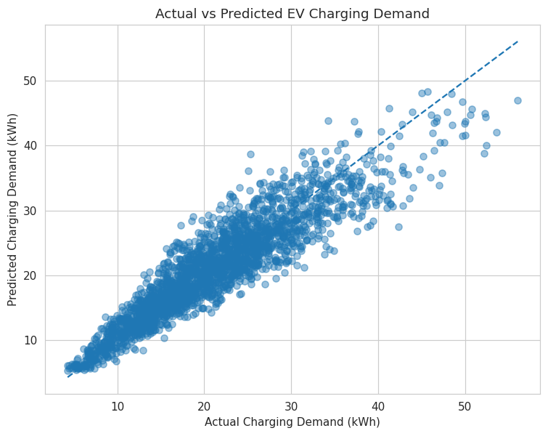
Model Results
Evaluated on the 2,400-record hold-out test set
DEMAND PREDICTION | Random Forest Regressor
ACTUAL vs PREDICTED (NOTEBOOK OUTPUT)
MAE
RMSE
R²
2.52 kWh
3.34 kWh
0.847
CONGESTION PREDICTION | RF Classifier (weighted avg)
Accuracy
Precision
Recall
F1 Score
0.680
0.685
0.680
0.679
Class | Precision | Recall | F1 | Support
High | 0.76 | 0.66 | 0.71 | 553
Low | 0.69 | 0.59 | 0.64 | 705
Medium | 0.64 | 0.74 | 0.69 | 1,142
Per-class report from the notebook (test set). Dashboard accuracy 93.6% covers all 12,000 scored records incl. training rows.
EVCharge Intelligence | 7 / 11
Notes:
The demand model has an MAE of 2.52 kWh, RMSE of 3.34 kWh and R squared of 0.847. The congestion classifier reaches about 68 percent accuracy on the test set. The 93.6 percent in the dashboard is measured on all 12,000 scored records, including training data.

Slide 8
Customer Feedback & Feature Importance
Feedback is summarised from the supplied sentiment labels; importance shows model reliance, not causation
CUSTOMER FEEDBACK ANALYSIS
Positive
Neutral
Negative
8,026
2,854
1,120
avg rating 4.49
avg rating 3.56
avg rating 2.35
Negative feedback: 0.03% (Low) • 0.58% (Medium) • 39.32% (High congestion). Lowest-rated station: DEL-ST-03 (3.91).
Importance reflects model reliance only — it does not prove causation.
EVCharge Intelligence | 8 / 11
Notes:
Most feedback is positive, and average rating falls from 4.58 at low congestion to 3.10 at high congestion. On the right, demand relies mostly on vehicle and connector type, while congestion relies on predicted demand and traffic. These show association, not causation.

Slide 9
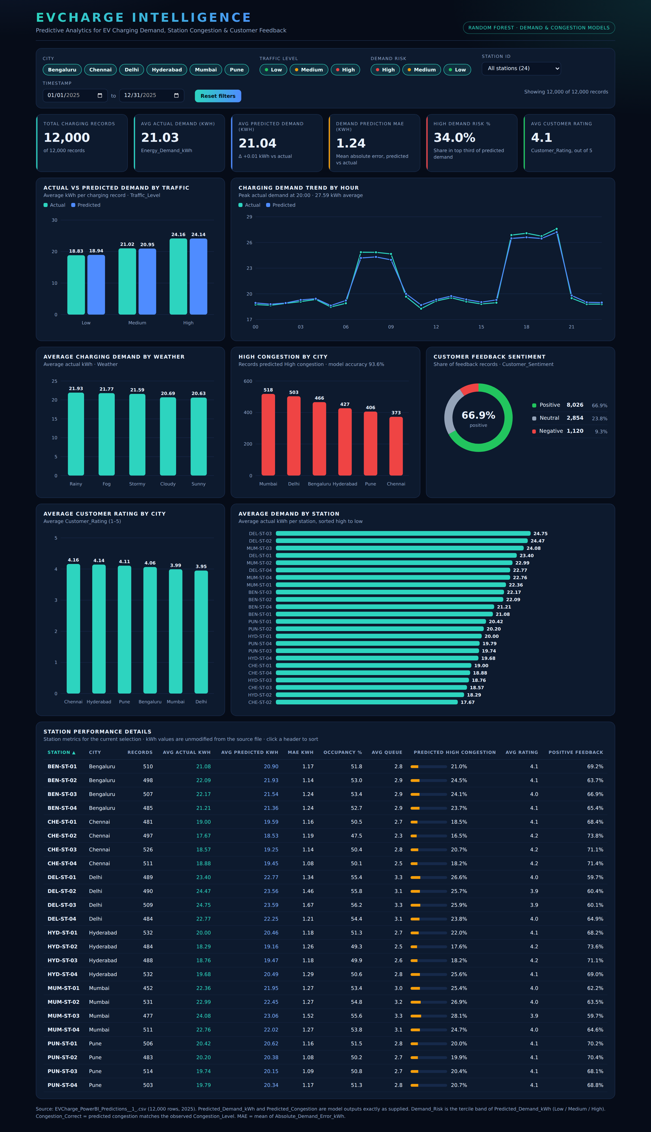
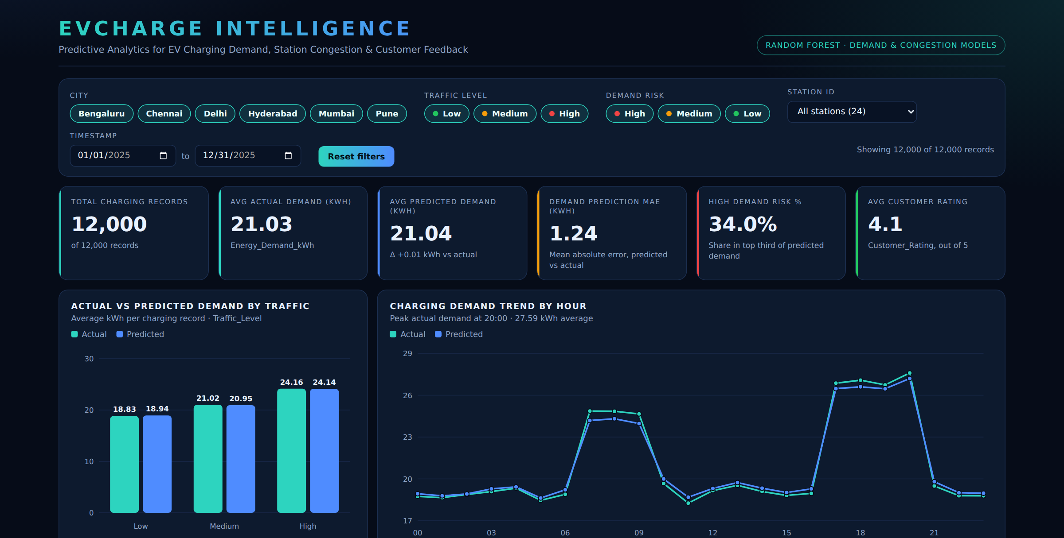
Power BI Dashboard
Interactive EVCharge Intelligence Dashboard
Interactive EVCharge Intelligence Dashboard — full page (left) and filters + KPI cards (right)
KPI cards
Demand analysis
Congestion analysis
Customer feedback
Station comparison
Filters / slicers
EVCharge Intelligence | 9 / 11
Notes:
This is our interactive dashboard built on the prediction output. It has KPI cards, demand and congestion charts, a customer sentiment view, station comparison and slicers for city, traffic, risk, station and date. Everything updates when a filter is applied.

Slide 10
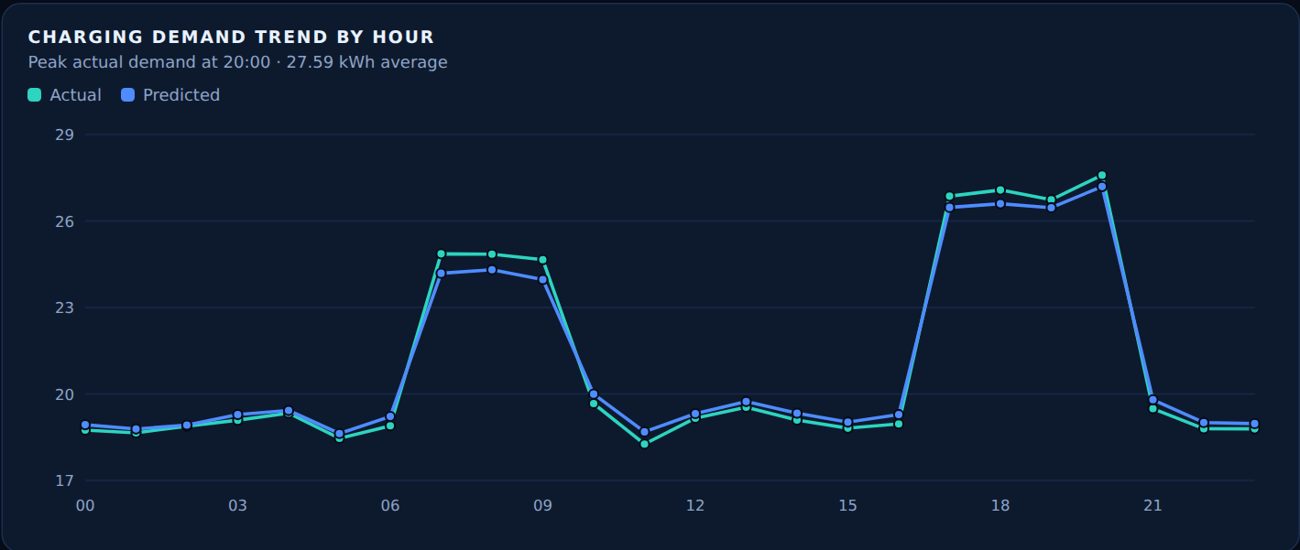
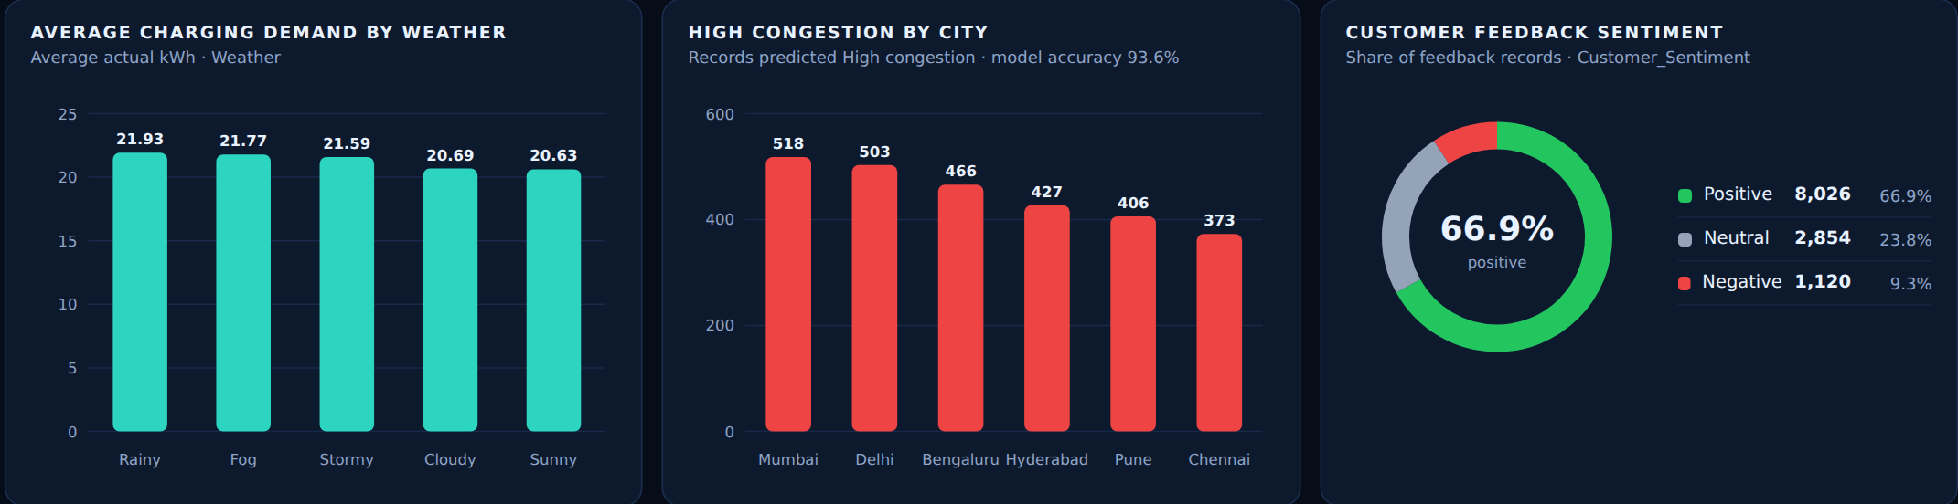
Key Insights & Business Value
Observation → Business value, from the dashboard data
High-traffic demand averages 24.16 kWh vs 18.83 kWh at low traffic
Supports capacity planning
→
Demand peaks at 17–20h (~27 kWh) and 07–09h (~25 kWh)
Supports peak-hour load planning
→
Mumbai (518) and Delhi (503) have the most predicted High-congestion records; Chennai the fewest (373)
Supports resource allocation across cities
→
Avg rating is 3.10 at High congestion vs 4.58 at Low; negative feedback 39.32% vs 0.03%
Helps flag experience problems tied to congestion
→
Avg demand by station ranges from 17.67 kWh (CHE-ST-02) to 24.75 kWh (DEL-ST-03)
Supports station-level planning
→
EVCharge Intelligence | 10 / 11
Notes:
Each insight is read directly from the dashboard. Demand rises with traffic and at peak hours, which supports capacity planning. Some cities have more high-congestion records, ratings drop when congestion is high, and station demand differs.

Slide 11
Conclusion & Future Scope
CONCLUSION
FUTURE SCOPE
Charging demand prediction was implemented
Congestion prediction was implemented
Customer feedback was analyzed
Results were integrated into Power BI
The system supports data-driven EV charging decisions
Real-time IoT data
Live traffic / weather integration
Real-time alerts
Advanced / deep learning forecasting
Web / mobile deployment
THANK YOU
Questions & Discussion
EVCharge Intelligence | 11 / 11
Notes:
We implemented demand prediction, congestion prediction and feedback analysis, and integrated everything into Power BI. Future work includes real-time IoT data, live traffic and weather, alerts, deep learning forecasting and web or mobile deployment. Thank you, we are happy to take questions.

